Slide 1
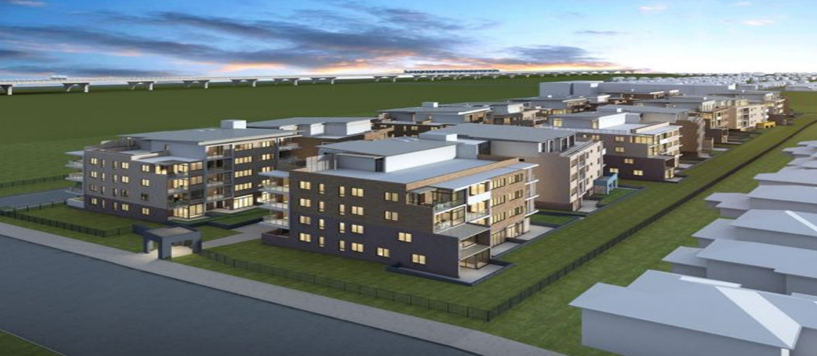
House price prediction project
By:-anshul dubey(internship-28)

Slide 2
TABLE OF CONTENTS
1- vAbstruct
2- vIntroduction
3- vProblem Statement
4- vConceptual Background of the Domain Problem
5- vData Sources and their formats
6- vAbout The DataSet
7- vData Preprocessing
8- vHardware and Software Requirements and Tools Used
9- vselected models
10-vAccuracy score of the model
11-vParameter tuning
12-vFinal model
13-vVisualizations
14-vInterpretation of the Results
15-vConclussion

Slide 3
Abstruct
Housing prices are an important reflection of the economy, and housing price ranges are of great interest for both buyers and sellers. In this project, house prices will be predicted given explanatory variables that cover many aspects of residential houses. The goal of this project is to create a regression model that is able to accurately estimate the price of the house given the features

Slide 4
Introduction
Thousands of houses are sold everyday. There are some questions every buyer asks himself like: What is the actual price that this house deserves? Am I paying a fair price? In this paper, a machine learning model is proposed to predict a house price based on data related to the house (its size, the year it was built in, etc.). This will facilitate the reproducibility of our work. In this study, Python programming language with a number of Python packages will be used.

Slide 5
Problem Statement
Houses are one of the necessary need of each and every person around the globe and therefore housing and real estate market is one of the markets which is one of the major contributors in the world’s economy. It is a very large market and there are various companies working in the domain. Data science comes as a very important tool to solve problems in the domain to help the companies increase their overall revenue, profits, improving their marketing strategies and focusing on changing trends in house sales and purchases. Predictive modelling, Market mix modelling, recommendation systems are some of the machine learning techniques used for achieving the business goals for housing companies. Our problem is related to one such housing company. A US-based housing company named Surprise Housing has decided to enter the Australian market. The company uses data analytics to purchase houses at a price below their actual values and flip them at a higher price. For the same purpose, the company has collected a data set from the sale of houses in Australia. The company is looking at prospective properties to buy houses to enter the market. I have to build a model using Machine Learning in order to predict the actual value of the prospective properties

Slide 6
Conceptual Background of the Domain Problem
we are going to work on a dataset which consists information about the location of the house, price and other aspects such as square feet etc. When we work on these sorts of data, we need to see which column is important for us and which is not. Our main aim today is to make a model which can give us a good prediction on the price of the house based on other variables. We are going to use Linear Regression for this dataset and see if it gives us a good accuracy or not.

Slide 7
Data Sources and their formats
I have imported the dataset which was in the csv file using pandas. The dataset contains 1168 rows and 81 columns having both numerical and categorical data. Here I can make use of PCA to reduce the columns, but this will give huge data loss. To avoid this, I am keeping the dataset as it is.
In this dataset " SalePrice" is our target variable which has float values. So this is a "Regression type" problem.
you can download the dataset from the below link.
Dataset link: https://github.com/anshuld1995/Housing-price-prediction

Slide 8
Data Preprocessing
we can see 50% or more data are missing in some columns .so we dropped this column to get a better analysis of the data.
• we divide all the columns into categorical and numerical types
• Univariate Analysis Of Categorical Columns and numerical columns.
• Drop ID column
• Drop the utility column to save one type of value.
• Checking correlation with target column using Heatmap
• Checking skewness of each columns
• Handling missing value
• Checking Outliers and removing outliers by zscore
• Encoding the categorical column by Label Encoder
• Dividing data into features and vectors
• Checking VIF score
• Removing skewness by power transform method
• Standardizing the data by standard scaler

Slide 9
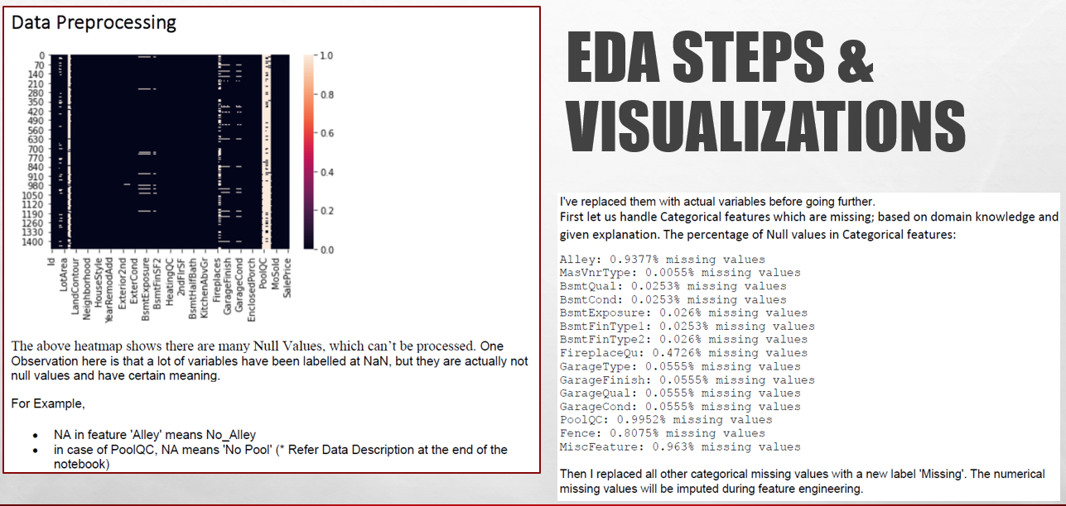

Slide 10
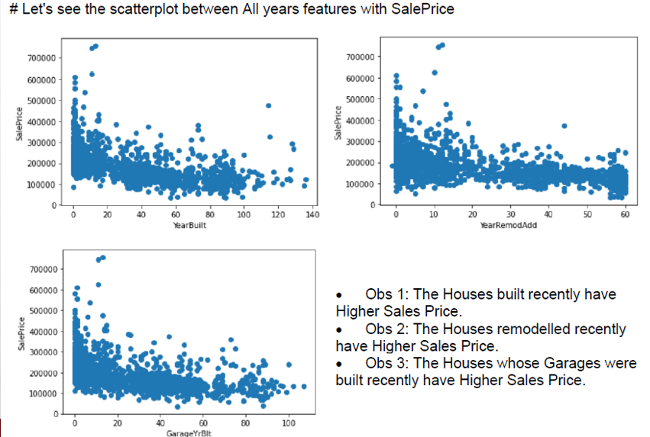
Scatterplots of Year Features vs Sales Price

Slide 11
Classifying Features - Numerical
•Identified all numerical features.
•Out of 79, there were 37 numerical features
•First Found out Temporal values (Year Features)

Slide 12
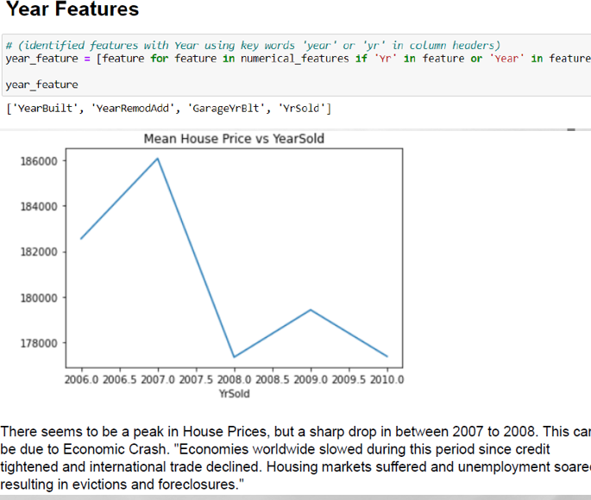
Year Features

Slide 13
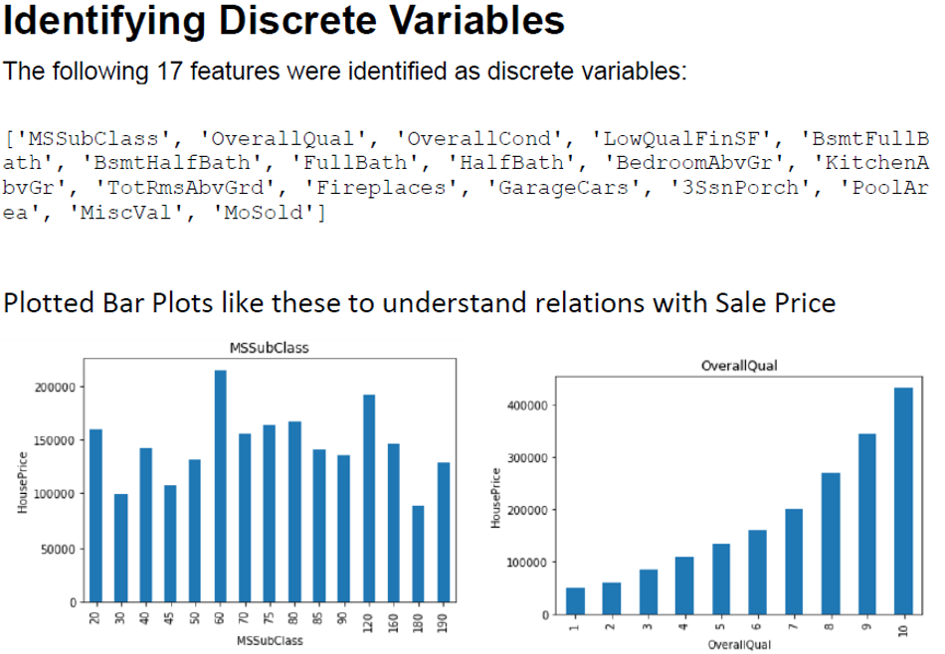
Out of 37 Numerical Features, identified 17 discrete features

Slide 14
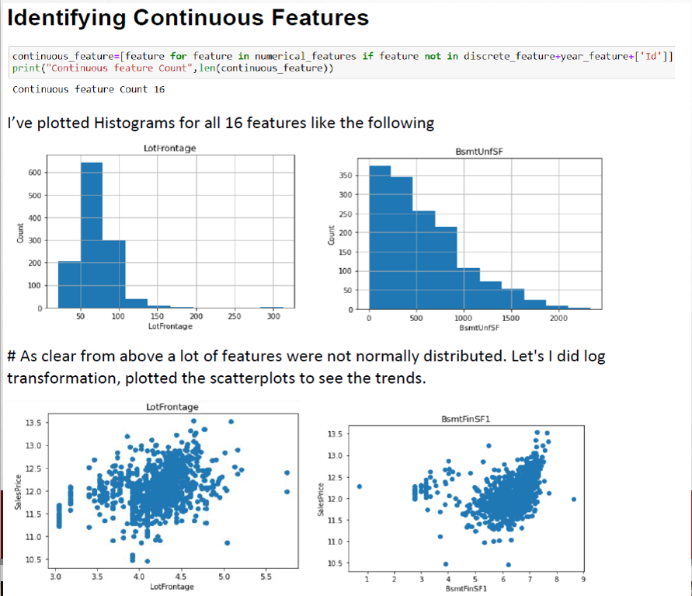
16 Continuous features out of 37 numerical features

Slide 15
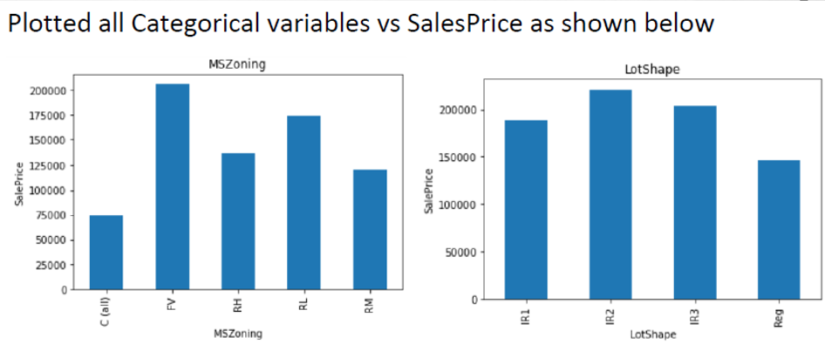
Categorical Features
•Total 43 categorical Features were identified.
​

Slide 16
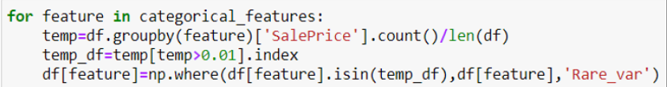
Feature Engineering Steps
Handling rear categorical feature

Slide 17

Label Encoding the Categorical

Slide 18
Skewness in some continuous variable so I HAVE to treat them with log1 Transformation but first I will divide then in into train and test ,
80% into train and 20% into test

Slide 19
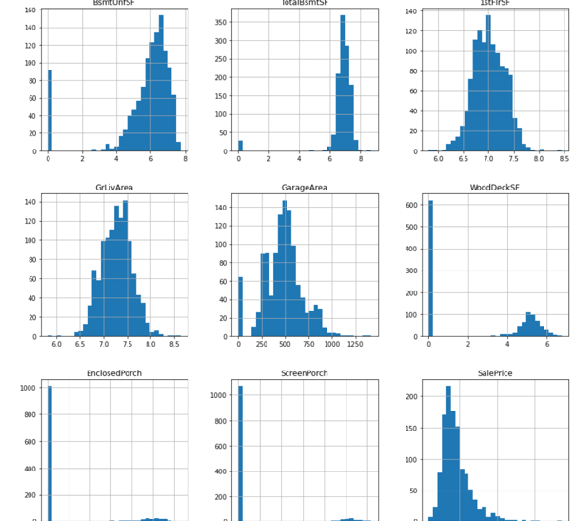
EXAMPLES OF DISTRIBUTIONS AFTER SKEWNESS REMOVED

Slide 20
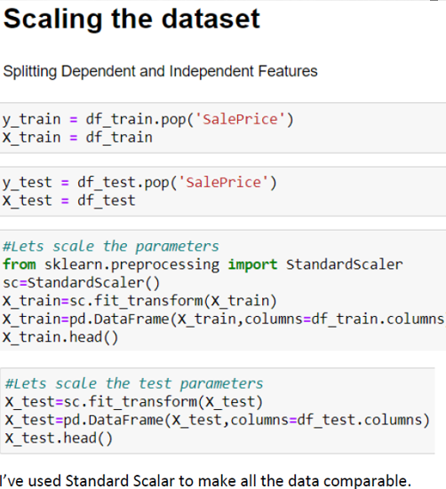
STANDARD SCALAR

Slide 21
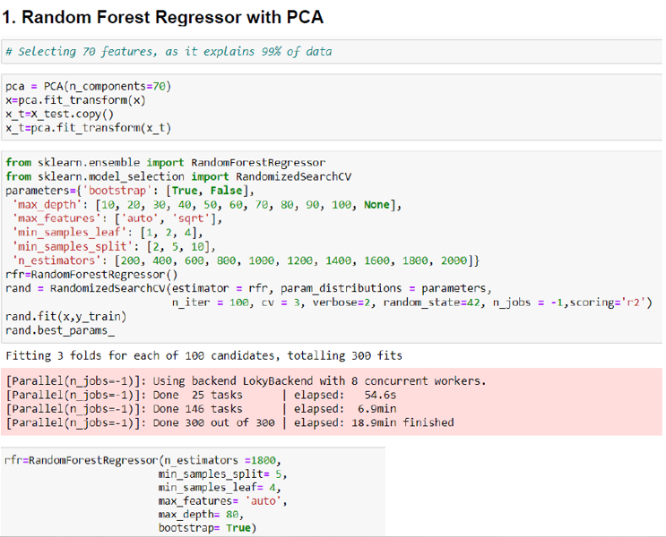
MODELLING

Slide 22
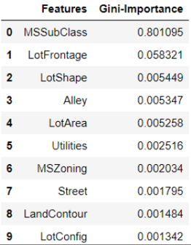
TOP 10 FEATURES BASED ON RANDOM FOREST REGRESSION

Slide 23
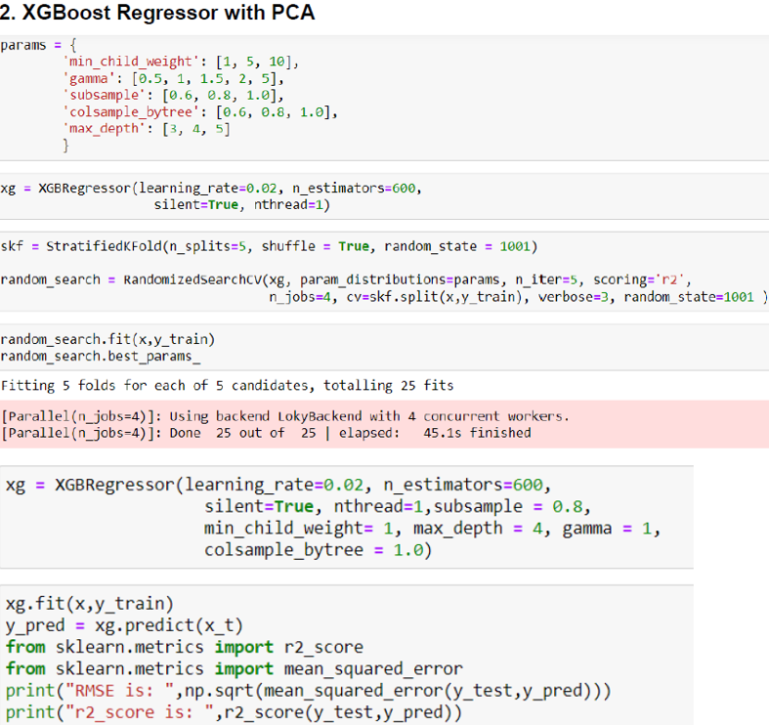
RESULT:
RMSE IS:43960.4070 r2_IS:0.748075
THE SCORE WAS LESS THAN RANDOM FOREST REGRESSION SO,I'VE REJECTED THIS MODEL

Slide 24
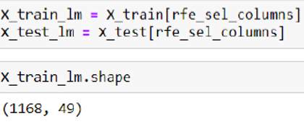
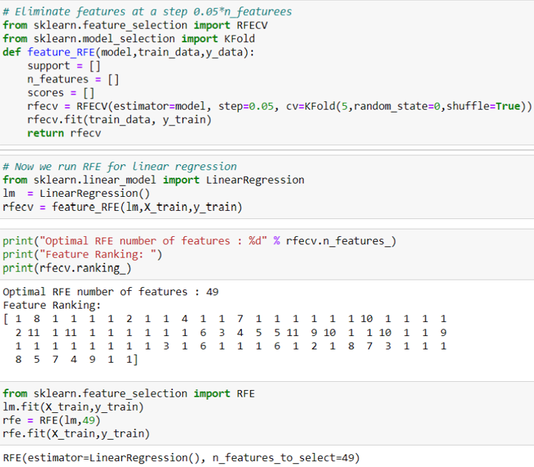
LINEAR REGRESSION WITH RFE(A – LASSO, B-RIDGE
Feature ranking with RFE (recursive feature elimination), that assigns weights to features e.g., the coefficients of a linear model. Here 49 features were

Slide 25
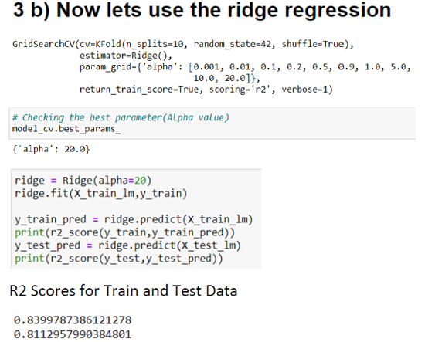
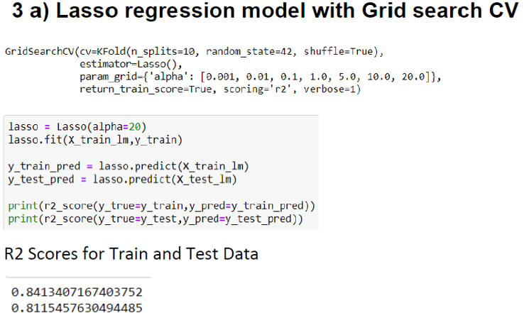
COMPARING LASSO AND RIDGE

Slide 26
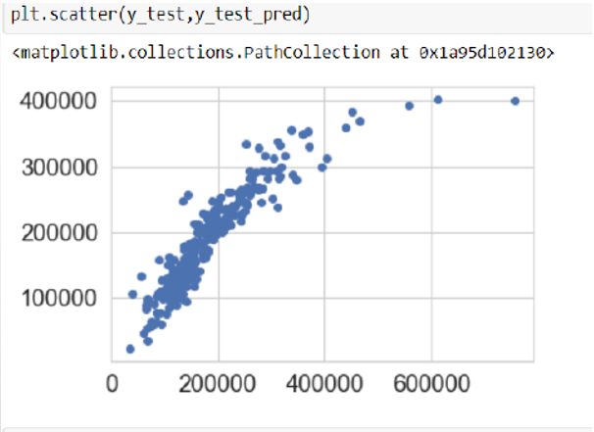
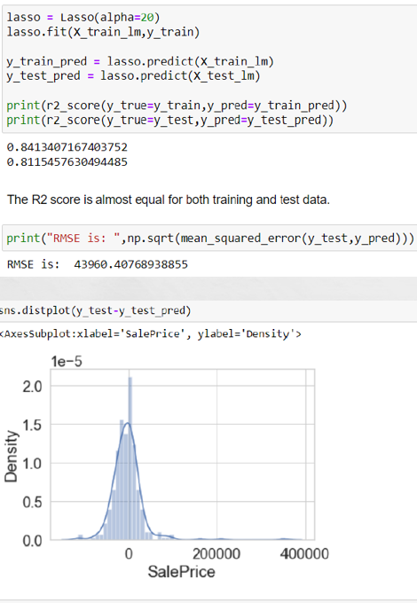
FINAL MODEL

Slide 27
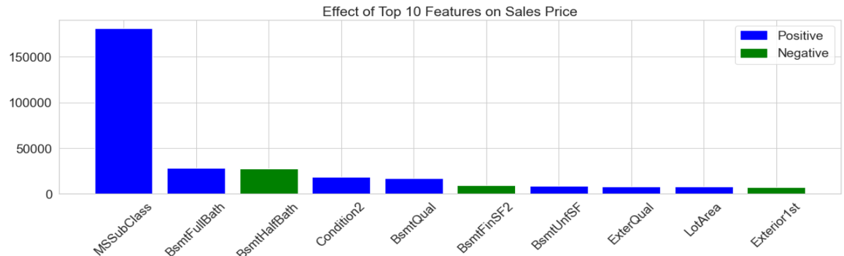
Effect of Top 10 Features Effecting Sales Price

Slide 28
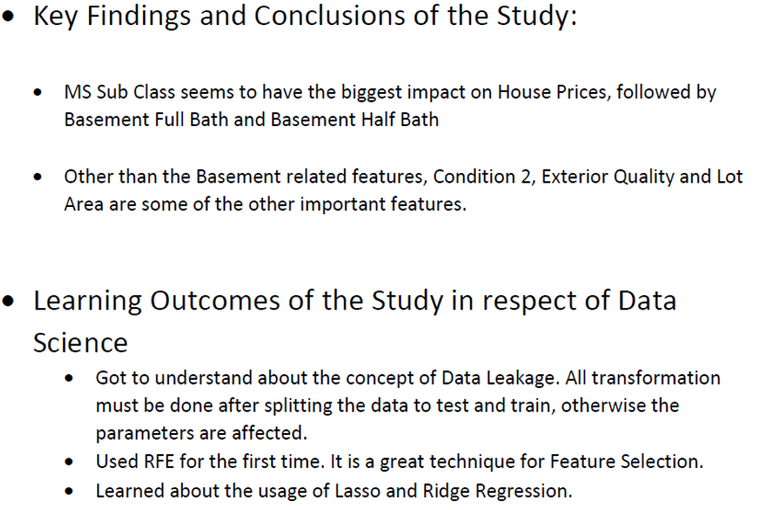
CONCLUSION

Slide 29
THANKYOU
MADE BY:-ANSHUL DUBEY

